Slide 1



📊 Railway Data Analytics Project
Uncovering Insights from Train Operations & Tickets Data
Presented by
Abdelrahman Hassan & Ahmed ElMaasrawi
Data Analysis Project
Under the supervision of
Eng. Ahmed Samir

Slide 2
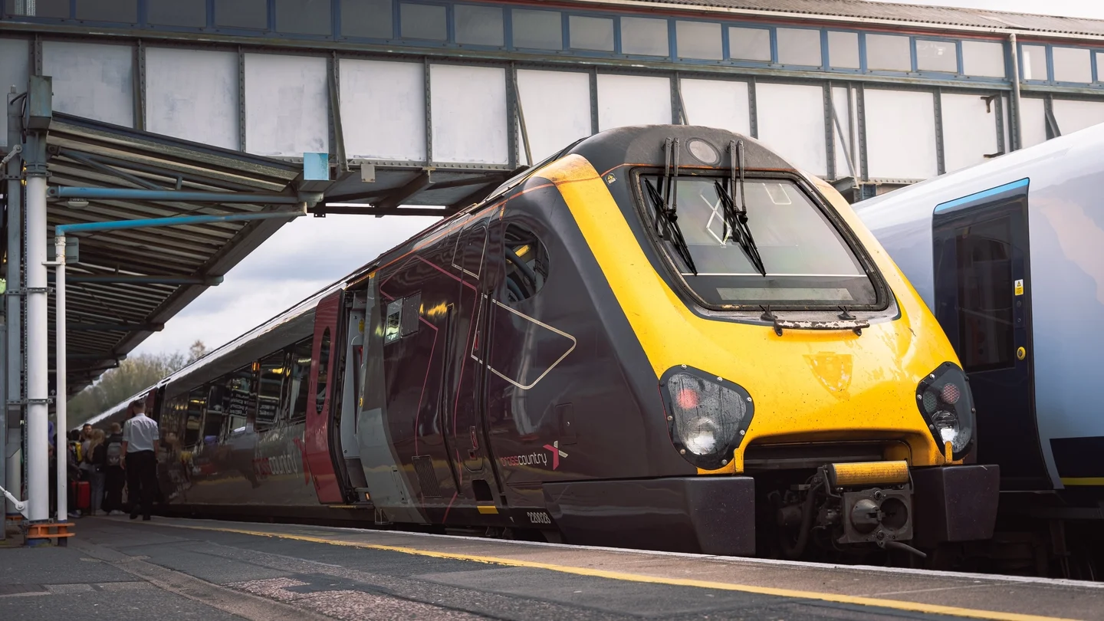

Slide 4






Introduction to Dataset
Data Cleaning, Wrangling and Normalization
Exploratory Data Analysis and Analysis Questions
Data Visualization Using Tableau
Predictions of Customer Retention
Recommendations and Conclusion
1
2
5
3
4
6

Slide 5
Introduction to Dataset
Data Cleaning, Wrangling and Normalization
Exploratory Data Analysis and Analysis Questions
Data Visualization Using Tableau
Predictions of Customer Retention
Recommendations and Conclusion
1
2
3
4
5
6

Slide 6






SQL played a crucial role in
Structuring the data through a well-defined schema
Enabled us to run efficient queries for answering key business and operational questions.
It was particularly useful for grouping, aggregations, and identifying patterns across large datasets
Tableau was our main tool for data visualization.
We created interactive dashboards to communicate insights clearly to stakeholders.
It also helped in exploring the data from different angles and validating findings discovered in Python and SQL.
Python was the core of our data processing workflow. We used it extensively for
Data cleaning, manipulation
Feature engineering
Normalization.
It allowed us to handle inconsistencies, transform the dataset, and prepare it for deeper analysis.
Excel was our starting point used for:
a quick look at the raw data
cross-checking values
ensuring that everything was running smoothly
It also supported some manual verifications while answering initial analysis questions.
Google Maps was integrated to extract accurate distances between stations, enriching our dataset for more precise pricing and route-based analysis.
Utilized Tools in this project

Slide 7
SQL played a crucial role in
Structuring the data through a well-defined schema
Enabled us to run efficient queries for answering key business and operational questions.
It was particularly useful for grouping, aggregations, and identifying patterns across large datasets
Tableau was our main tool for data visualization.
We created interactive dashboards to communicate insights clearly to stakeholders.
It also helped in exploring the data from different angles and validating findings discovered in Python and SQL.
Python was the core of our data processing workflow. We used it extensively for
Data cleaning, manipulation
Feature engineering
Normalization.
It allowed us to handle inconsistencies, transform the dataset, and prepare it for deeper analysis.
Excel was our starting point used for:
a quick look at the raw data
cross-checking values
ensuring that everything was running smoothly
It also supported some manual verifications while answering initial analysis questions.
Google Maps was integrated to extract accurate distances between stations, enriching our dataset for more precise pricing and route-based analysis.
Utilized Tools in this project

Slide 8
SQL played a crucial role in
Structuring the data through a well-defined schema
Enabled us to run efficient queries for answering key business and operational questions.
It was particularly useful for grouping, aggregations, and identifying patterns across large datasets
Tableau was our main tool for data visualization.
We created interactive dashboards to communicate insights clearly to stakeholders.
It also helped in exploring the data from different angles and validating findings discovered in Python and SQL.
Python was the core of our data processing workflow. We used it extensively for
Data cleaning, manipulation
Feature engineering
Normalization.
It allowed us to handle inconsistencies, transform the dataset, and prepare it for deeper analysis.
Excel was our starting point used for:
a quick look at the raw data
cross-checking values
ensuring that everything was running smoothly
It also supported some manual verifications while answering initial analysis questions.
Google Maps was integrated to extract accurate distances between stations, enriching our dataset for more precise pricing and route-based analysis.
Utilized Tools in this project

Slide 9
SQL played a crucial role in
Structuring the data through a well-defined schema
Enabled us to run efficient queries for answering key business and operational questions.
It was particularly useful for grouping, aggregations, and identifying patterns across large datasets
Tableau was our main tool for data visualization.
We created interactive dashboards to communicate insights clearly to stakeholders.
It also helped in exploring the data from different angles and validating findings discovered in Python and SQL.
Python was the core of our data processing workflow. We used it extensively for
Data cleaning, manipulation
Feature engineering
Normalization.
It allowed us to handle inconsistencies, transform the dataset, and prepare it for deeper analysis.
Excel was our starting point used for:
a quick look at the raw data
cross-checking values
ensuring that everything was running smoothly
It also supported some manual verifications while answering initial analysis questions.
Google Maps was integrated to extract accurate distances between stations, enriching our dataset for more precise pricing and route-based analysis.
Utilized Tools in this project

Slide 10
SQL played a crucial role in
Structuring the data through a well-defined schema
Enabled us to run efficient queries for answering key business and operational questions.
It was particularly useful for grouping, aggregations, and identifying patterns across large datasets
Tableau was our main tool for data visualization.
We created interactive dashboards to communicate insights clearly to stakeholders.
It also helped in exploring the data from different angles and validating findings discovered in Python and SQL.
Python was the core of our data processing workflow. We used it extensively for
Data cleaning, manipulation
Feature engineering
Normalization.
It allowed us to handle inconsistencies, transform the dataset, and prepare it for deeper analysis.
Excel was our starting point used for:
a quick look at the raw data
cross-checking values
ensuring that everything was running smoothly
It also supported some manual verifications while answering initial analysis questions.
Google Maps was integrated to extract accurate distances between stations, enriching our dataset for more precise pricing and route-based analysis.
Utilized Tools in this project

Slide 11
SQL played a crucial role in
Structuring the data through a well-defined schema
Enabled us to run efficient queries for answering key business and operational questions.
It was particularly useful for grouping, aggregations, and identifying patterns across large datasets
Tableau was our main tool for data visualization.
We created interactive dashboards to communicate insights clearly to stakeholders.
It also helped in exploring the data from different angles and validating findings discovered in Python and SQL.
Python was the core of our data processing workflow. We used it extensively for
Data cleaning, manipulation
Feature engineering
Normalization.
It allowed us to handle inconsistencies, transform the dataset, and prepare it for deeper analysis.
Excel was our starting point used for:
a quick look at the raw data
cross-checking values
ensuring that everything was running smoothly
It also supported some manual verifications while answering initial analysis questions.
Google Maps was integrated to extract accurate distances between stations, enriching our dataset for more precise pricing and route-based analysis.
Utilized Tools in this project

Slide 12
SQL played a crucial role in
Structuring the data through a well-defined schema
Enabled us to run efficient queries for answering key business and operational questions.
It was particularly useful for grouping, aggregations, and identifying patterns across large datasets
Tableau was our main tool for data visualization.
We created interactive dashboards to communicate insights clearly to stakeholders.
It also helped in exploring the data from different angles and validating findings discovered in Python and SQL.
Python was the core of our data processing workflow. We used it extensively for
Data cleaning, manipulation
Feature engineering
Normalization.
It allowed us to handle inconsistencies, transform the dataset, and prepare it for deeper analysis.
Excel was our starting point used for:
a quick look at the raw data
cross-checking values
ensuring that everything was running smoothly
It also supported some manual verifications while answering initial analysis questions.
Google Maps was integrated to extract accurate distances between stations, enriching our dataset for more precise pricing and route-based analysis.
Utilized Tools in this project

Slide 13
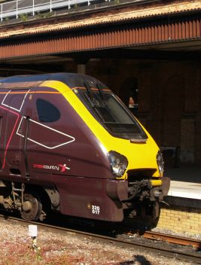
Introduction to Dataset
✅ Chapter 1 – Dataset Introduction
1
📂 Dataset Introduction
Main Points:
Project Focus: Analyze UK railway data to understand:
Customer behavior
Service efficiency
Operational performance
Why It Matters: A deep understanding of the dataset is crucial before cleaning, transforming, or modeling the data.

Slide 14



Introduction to Dataset
Structure Summary
1
Number of records
Number of Columns
Primary Key
Rows: 31,653
Columns: 18
Primary Key: Transaction ID (unique for each purchase)
1 record = 1 ticket transaction

Slide 15
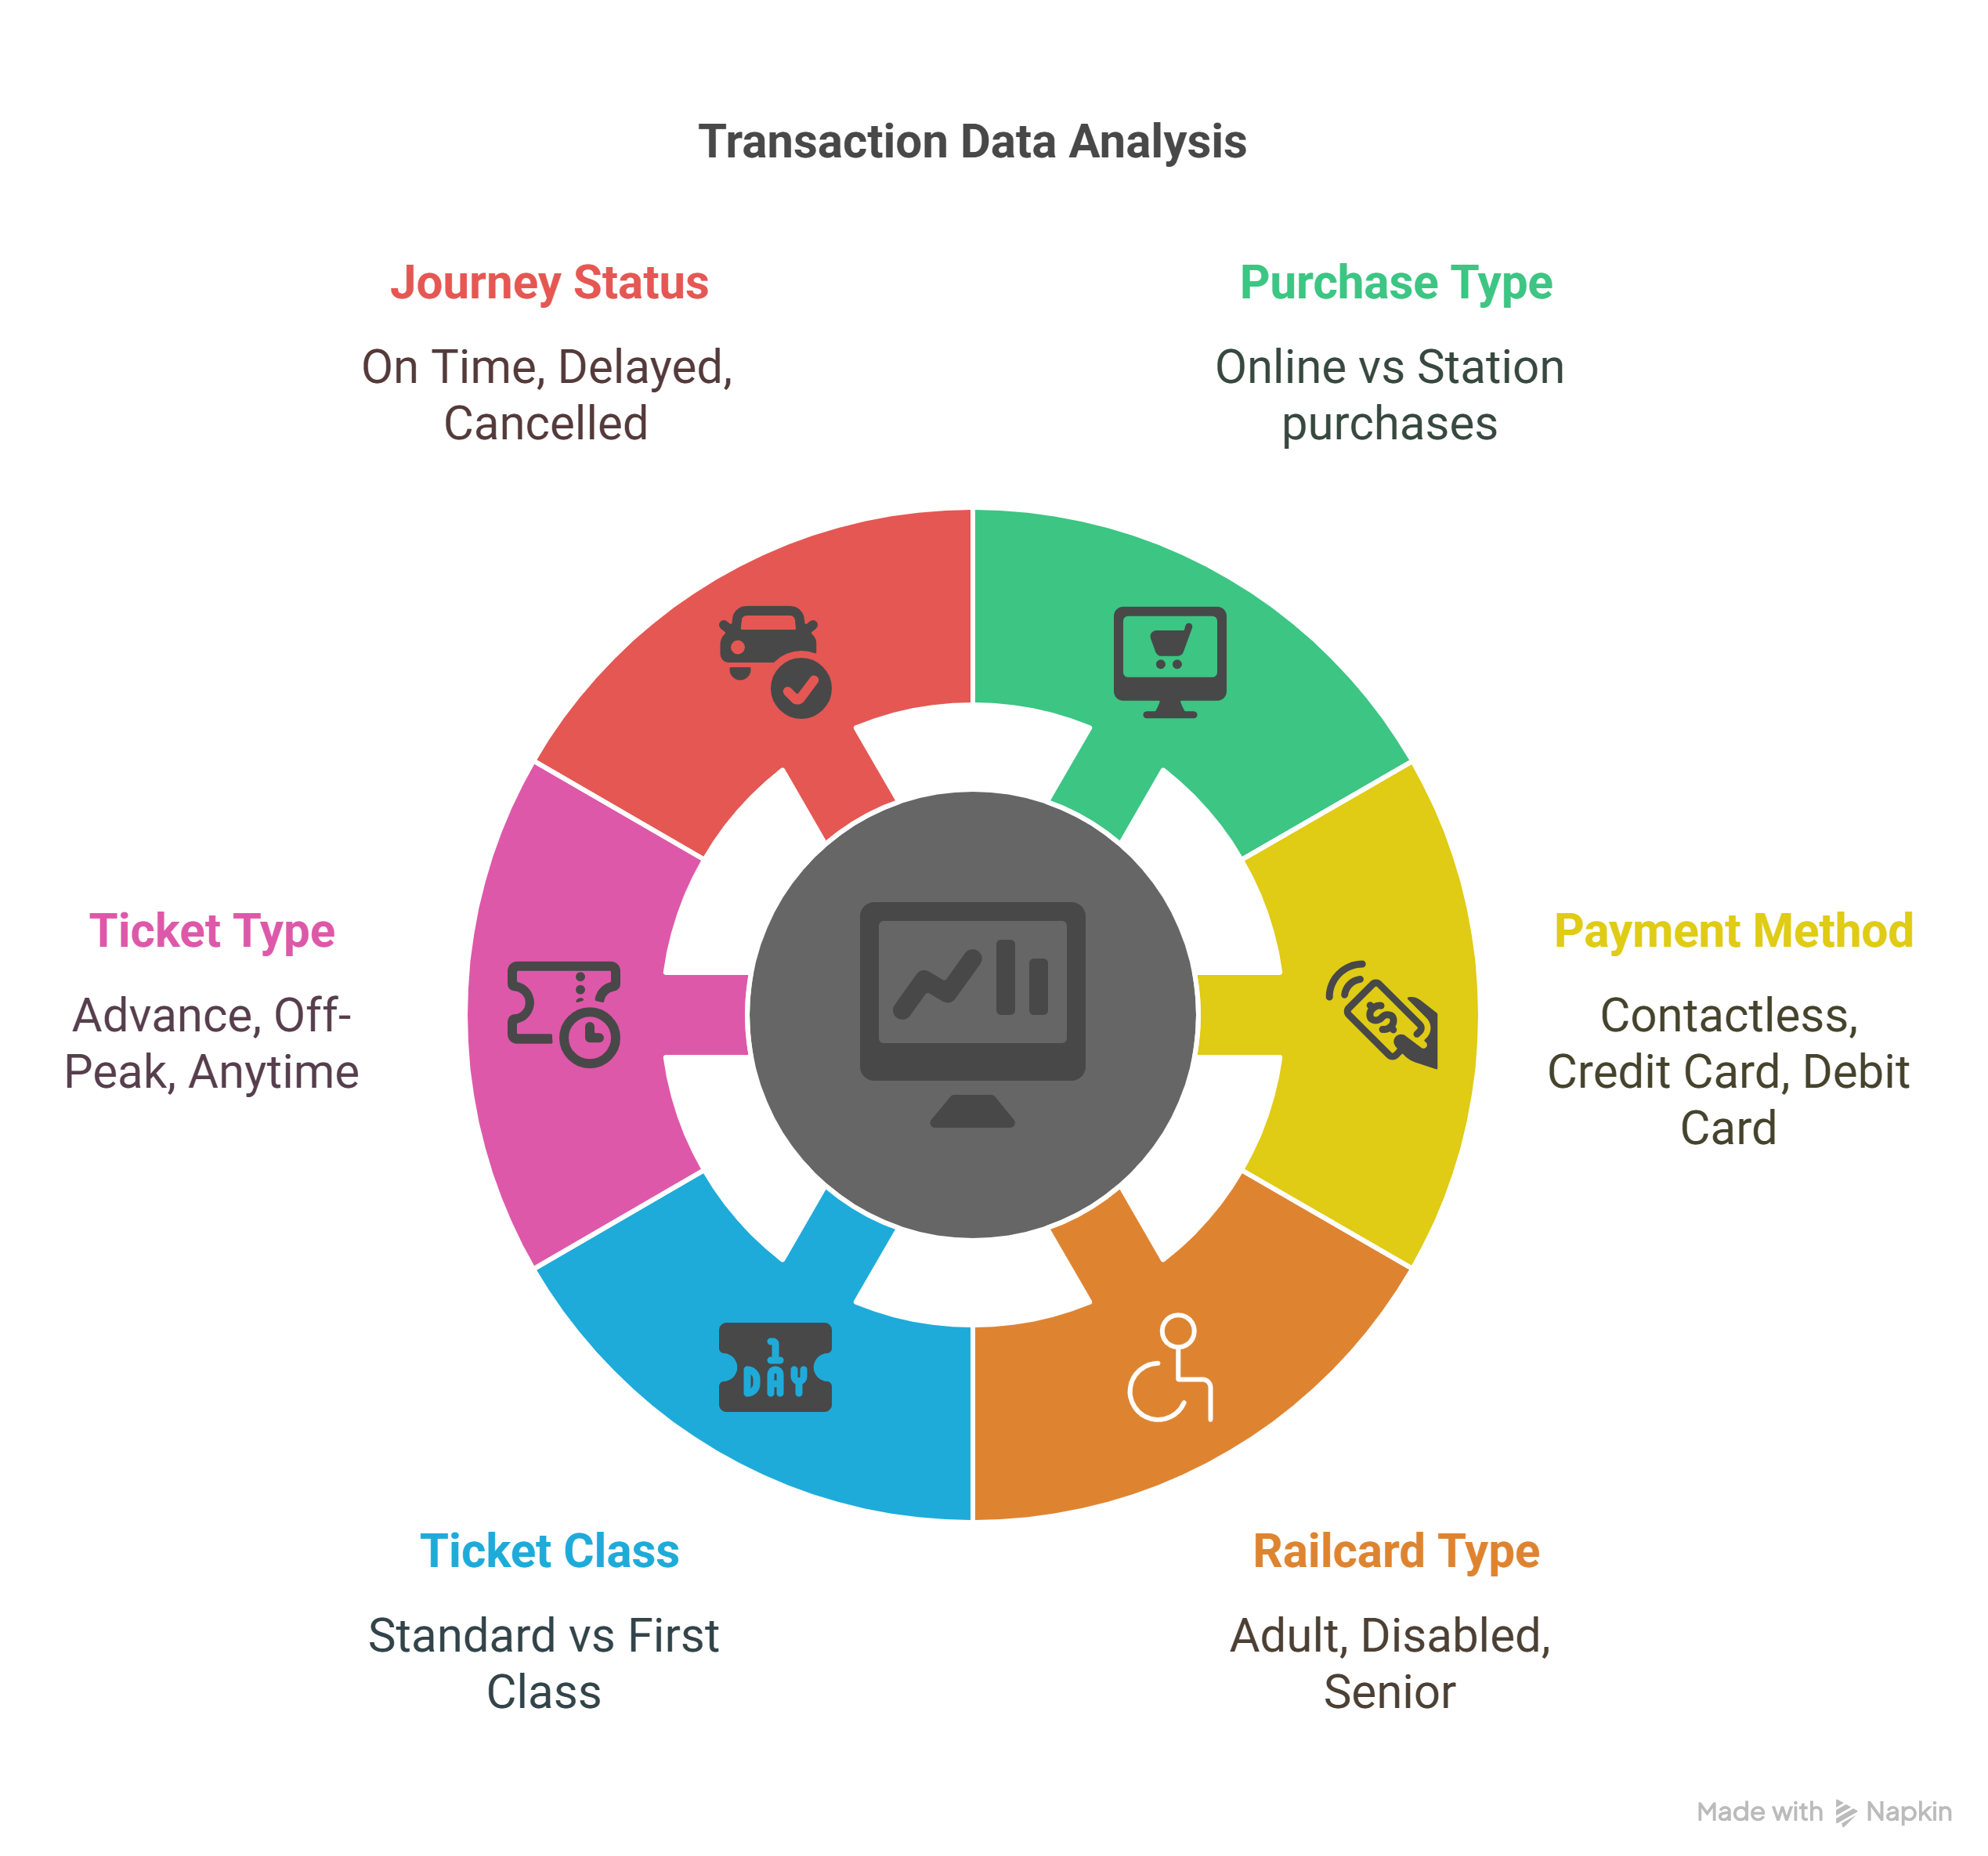
Introduction to Dataset
1

Slide 16
Introduction to Dataset
Main Columns Data Types
1
 | Column Example | Description | Data Type
 | Transaction ID | Unique ID for each record | Categorical (String)
 | Date of Purchase, Date of Journey | Calendar date fields | Date
 | Time of Purchase, Departure Time | Time of day fields | Time
 | Payment Method | Payment type (Credit Card, Contactless) | Categorical
 | Purchase Type | Where the ticket was purchased (Online/Station) | Categorical
 | Railcard | Type of railcard used (Adult, Senior, etc.) | Categorical
 | Ticket Class | Travel class (Standard, First) | Categorical
 | Ticket Type | Advance, Off-Peak, Anytime | Categorical
 | Price | Ticket cost in GBP | Numeric (Float)
 | Departure/Arrival Stations | Names of train stations | Categorical
 | Journey Status | Status of the trip (On Time, Delayed) | Categorical
 | Reason for Delay | Delay explanation if applicable | Categorical (Nullable)
 | Refund Request | Yes or No value | Boolean
 | Arrival / Actual Arrival Time | Time train was scheduled/actually arrived | Time

Slide 17
Introduction to Dataset
Data Cleaning, Wrangling and Normalization
Exploratory Data Analysis and Analysis Questions
Data Visualization Using Tableau
Predictions of Customer Retention
Recommendations and Conclusion
1
2
3
4
5
6

Slide 18
Introduction to Dataset
Data Cleaning, Wrangling and Normalization
Exploratory Data Analysis and Analysis Questions
Data Visualization Using Tableau
Predictions of Customer Retention
Recommendations and Conclusion
1
2
3
4
5
6

Slide 19
Data Cleaning, Wrangling and Normalization
2
🧹 Chapter 2: Data Cleaning & Wrangling
📏 Why?
Data cleaning and wrangling is a crucial step in the data analysis process. Raw data often contains inconsistencies, missing values, duplicates, and errors, which need to be addressed before performing any meaningful analysis.

Slide 20
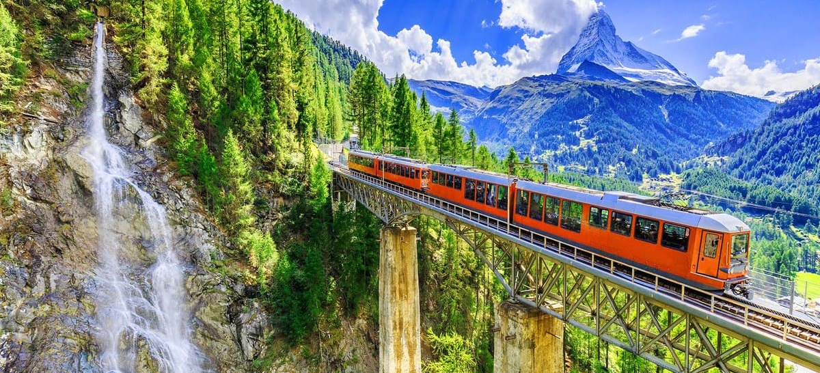
Handling Missing Data:
Remove or fill missing values using techniques like mean, median, or forward fill.
pandas functions: df.dropna(), df.fillna()
Removing Duplicates:
Ensure there are no duplicate records in your dataset.
pandas function: df.drop_duplicates()
Data Transformation:
Convert data types where necessary (e.g., strings to integers or dates).
pandas function: df.astype(), pd.to_datetime()
Handling Outliers:
Identify and handle outliers to prevent them from skewing analysis.
Use IQR (Interquartile Range) or Z-scores for detection.
Normalizing & Scaling Data:
Data normalization is the process of organizing data into multiple related tables to eliminate duplication, minimize redundancy, and ensure logical data storage. This is achieved by applying a series of rules known as normal forms (NF).
Data Cleaning & Wrangling
Part 1
Part 2
Part 3
Part 5
Part 4

Slide 21
Handling Missing Data:
Remove or fill missing values using techniques like mean, median, or forward fill.
pandas functions: df.dropna(), df.fillna()
Removing Duplicates:
Ensure there are no duplicate records in your dataset.
pandas function: df.drop_duplicates()
Data Transformation:
Convert data types where necessary (e.g., strings to integers or dates).
pandas function: df.astype(), pd.to_datetime()
Handling Outliers:
Identify and handle outliers to prevent them from skewing analysis.
Use IQR (Interquartile Range) or Z-scores for detection.
Normalizing & Scaling Data:
Data normalization is the process of organizing data into multiple related tables to eliminate duplication, minimize redundancy, and ensure logical data storage. This is achieved by applying a series of rules known as normal forms (NF).
Part 1
Data Cleaning & Wrangling
Part 2
Part 3
Part 4
Part 5

Slide 22
Handling Missing Data:
Remove or fill missing values using techniques like mean, median, or forward fill.
pandas functions: df.dropna(), df.fillna()
Removing Duplicates:
Ensure there are no duplicate records in your dataset.
pandas function: df.drop_duplicates()
Data Transformation:
Convert data types where necessary (e.g., strings to integers or dates).
pandas function: df.astype(), pd.to_datetime()
Handling Outliers:
Identify and handle outliers to prevent them from skewing analysis.
Use IQR (Interquartile Range) or Z-scores for detection.
Normalizing & Scaling Data:
Data normalization is the process of organizing data into multiple related tables to eliminate duplication, minimize redundancy, and ensure logical data storage. This is achieved by applying a series of rules known as normal forms (NF).
Part 1
Part 2
Data Cleaning & Wrangling
Part 3
Part 4
Part 5

Slide 23
Handling Missing Data:
Remove or fill missing values using techniques like mean, median, or forward fill.
pandas functions: df.dropna(), df.fillna()
Removing Duplicates:
Ensure there are no duplicate records in your dataset.
pandas function: df.drop_duplicates()
Data Transformation:
Convert data types where necessary (e.g., strings to integers or dates).
pandas function: df.astype(), pd.to_datetime()
Handling Outliers:
Identify and handle outliers to prevent them from skewing analysis.
Use IQR (Interquartile Range) or Z-scores for detection.
Normalizing & Scaling Data:
Data normalization is the process of organizing data into multiple related tables to eliminate duplication, minimize redundancy, and ensure logical data storage. This is achieved by applying a series of rules known as normal forms (NF).
Part 1
Part 2
Part 3
Data Cleaning & Wrangling
Part 4
Part 5

Slide 24
Handling Missing Data:
Remove or fill missing values using techniques like mean, median, or forward fill.
pandas functions: df.dropna(), df.fillna()
Removing Duplicates:
Ensure there are no duplicate records in your dataset.
pandas function: df.drop_duplicates()
Data Transformation:
Convert data types where necessary (e.g., strings to integers or dates).
pandas function: df.astype(), pd.to_datetime()
Handling Outliers:
Identify and handle outliers to prevent them from skewing analysis.
Use IQR (Interquartile Range) or Z-scores for detection.
Normalizing & Scaling Data:
Data normalization is the process of organizing data into multiple related tables to eliminate duplication, minimize redundancy, and ensure logical data storage. This is achieved by applying a series of rules known as normal forms (NF).
Part 1
Part 2
Part 3
Part 4
Data Cleaning & Wrangling
Part 5

Slide 25
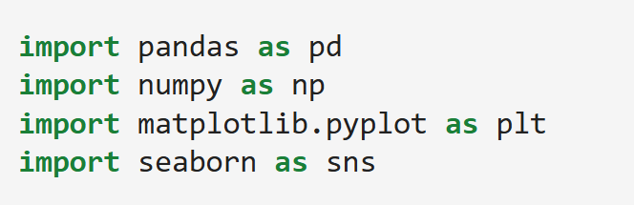


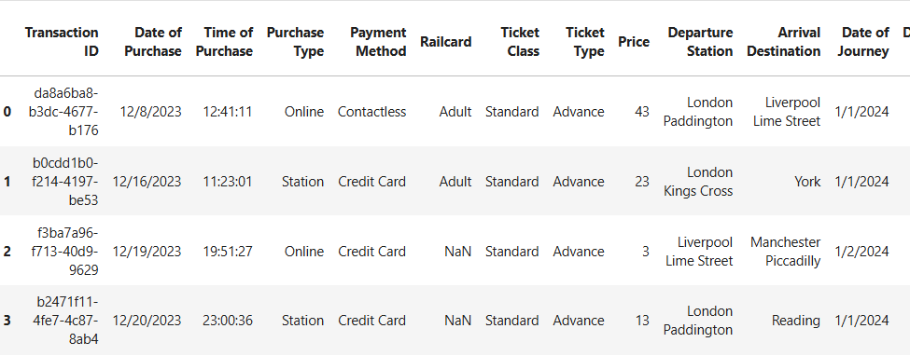
Data Cleaning, Wrangling and Normalization
Importing Required Libraries
2
These are the core Python libraries used for data manipulation (pandas, numpy) and visualization (matplotlib, seaborn).
🔍 df.head(): Provides a snapshot of the data format and column names.

Slide 26


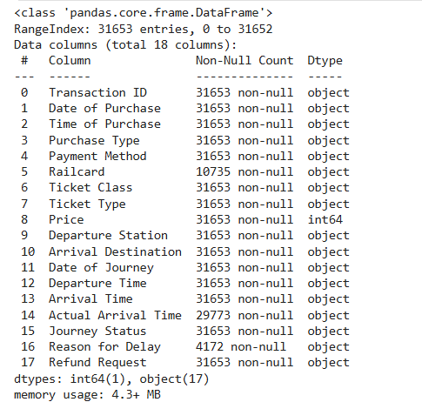
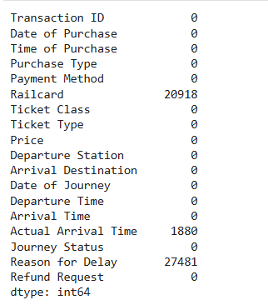
Data Cleaning, Wrangling and Normalization
2
Overview of data and null Values

Slide 27
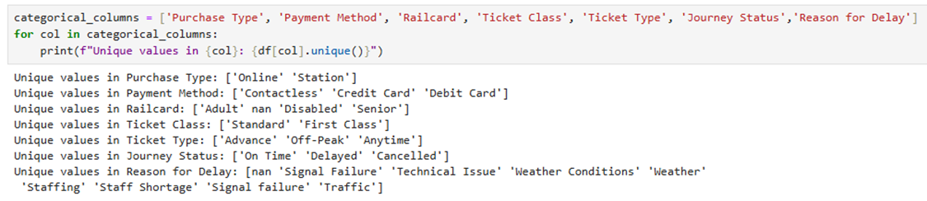
Data Cleaning, Wrangling and Normalization
2
🧾 Step 5: Checking Unique Values in Categorical Columns
📏 Why? Checks and prints unique values in specified categorical columns.
📋 categorical_columns: A list of columns with text or non-numeric data.
🔁 For loop: Goes through each column to extract its unique values.
🔎 df[col].unique(): Returns distinct values in each column.

Slide 28
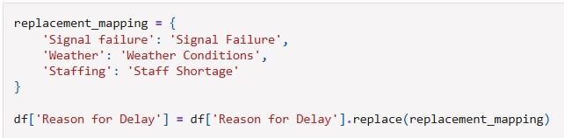
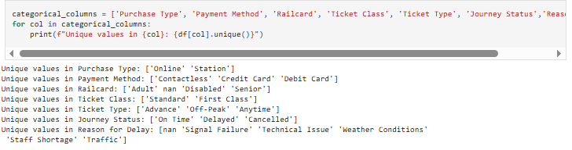
Data Cleaning, Wrangling and Normalization
🔄 Standardizing Categorical Values
2
🎯 Objective: Ensure consistency in the "Reason for Delay" column by cleaning and unifying categorical entries.
What We Did: Used a dictionary to replace inconsistent entries with standardized labels:
✅ Why It Matters:
Fixes inconsistencies in capitalization and terminology
Helps ensure reliable grouping and analysis
Prepares data for cleaner visuals and accurate modeling

Slide 29

Data Cleaning, Wrangling and Normalization
🧼 Handling Missing Values in Categorical Columns
2
🎯 Objective: Fill missing values in the "Railcard" column with a meaningful default category.
✅ Why It Matters:
Fills null or NaN values in ‘Railcard ’with 'No card' to represent passengers without a railcard, and in “Reason for Delay” with 'No delay’ for on-time journeys.
Prevents issues during analysis and modeling that rely on complete data.
inplace=True ensures the original DataFrame is updated directly.

Slide 30
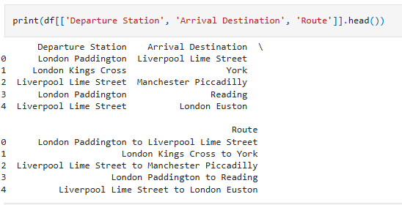
Data Cleaning, Wrangling and Normalization
🛤 Creating a Route Column
2
🎯 Objective: Generate a clear and human-readable trip route in one column by combining departure and arrival locations.
🧠 What We Did:
Merged "Departure Station" and "Arrival Destination" with ' to ' as a separator
Created a new column "Route" with values like: London Euston to Manchester Piccadilly
✅ Why It Matters:
Simplifies visualizations and route-based analysis
Useful for grouping trips by origin–destination pair
Enhances readability for dashboards and reports

Slide 31
Data Cleaning, Wrangling and Normalization
⏱ Calculating Delay in Minutes
2
🎯 Objective: Measure the actual delay for each journey in minutes, using the scheduled and actual arrival times.
✅ Why It Matters:
Provides a clear, quantitative measure of delay
Enables analysis of delay distribution, averages, and outliers
Critical for performance evaluation across routes, dates, or operators

Slide 32
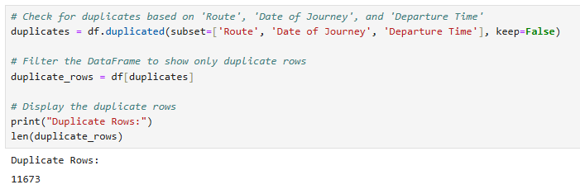
Data Cleaning, Wrangling and Normalization
🚨 Checking for Duplicate Entries Based on Key Columns
2
🎯 Objective: Identify and review duplicate entries based on key columns: Route, Date of Journey, and Departure Time.
🧠 What We Did:
Checked for duplicates based on the combination of Route, Date of Journey, and Departure Time
Used keep=False to mark all duplicates (not just the second occurrence)
Displayed the rows that are identified as duplicates
Notes:
✅ Why It Matters:
Duplicate rows can distort analysis and lead to incorrect conclusions
Ensures the dataset accurately reflects unique trips
Helps identify and address data quality issues early

Slide 33
Data Cleaning, Wrangling and Normalization
2
📊Normalization
Data normalization is the process of organizing data into multiple related tables to eliminate duplication, minimize redundancy, and ensure logical data storage.

Slide 34

Data Cleaning, Wrangling and Normalization
2
🔄 Preparing the Trips Table by Removing Duplicates
Notes:
✅ Why It Matters:
Ensures Data Integrity: Removing duplicates ensures that each trip is represented by a single, unique record, preventing repetition and errors in further analysis.
Accurate Analysis: Duplicates can lead to incorrect conclusions by counting the same trip multiple times, which would distort averages, trends, or predictions.
Prepares for Further Processing: By eliminating redundant data, this step helps ensure that no unnecessary rows interfere with subsequent processes, like normalization or modeling.
Optimizes Performance: Fewer records lead to faster processing and analysis, which is crucial as the dataset grows larger.

Slide 35
Data Cleaning, Wrangling and Normalization
2
🔗 Merging "Trip ID" into the Original DataFrame
🎯 Objective: Merge the Trip ID from the trips DataFrame into the original df DataFrame based on matching Route, Date of Journey, and Departure Time.
✅ Why It Matters:
Unique Identification: Merging the Trip ID allows each row in the original dataset (df) to have a unique identifier, making it easier to track and reference individual trips.
Facilitates Analysis: With Trip ID added to the original data, you can easily link trips across different datasets or perform detailed analysis using a consistent identifier.
Ensures Data Integrity: The left join ensures that no records are lost in the merging process, and only matching rows are brought in, preserving the integrity of the data.
Optimizes Future Data Operations: Having a unique Trip ID simplifies subsequent operations like filtering, grouping, or creating visualizations by referencing individual trips.

Slide 36

Data Cleaning, Wrangling and Normalization
2
🔍 Identifying Unique Departure and Arrival Stations
🎯 Objective: Extract unique values from the Departure Station and Arrival Destination columns and store them in separate arrays.
🧠 What We Did:
Used df['Departure Station'].unique() to return an array of unique departure stations in the dataset.
Used df['Arrival Destination'].unique() to return an array of unique arrival destinations in the dataset.
Merged the two arrays of unique departure stations and unique arrival destinations.
Combined array to extract the unique values, ensuring no station is repeated in the final list.

Slide 37
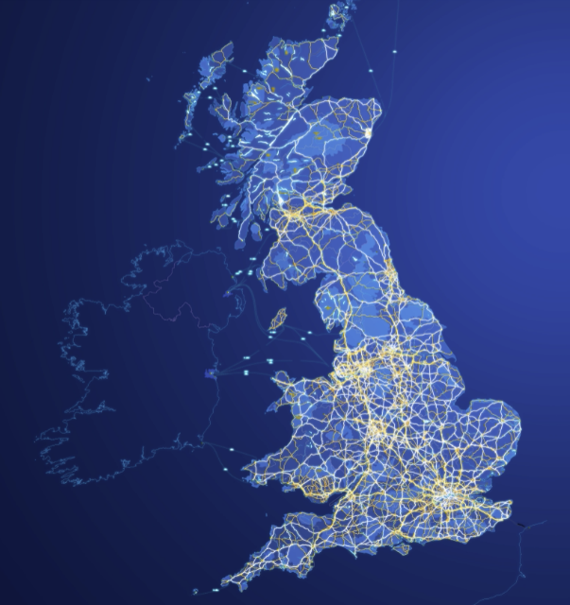

Data Cleaning, Wrangling and Normalization
2
🛠 Installing Geopy for Geospatial Operations to prepare for geospatial anallsysi
🎯 Objective: Install the Geopy library to enable geospatial operations such as geocoding and distance calculations.

Slide 38
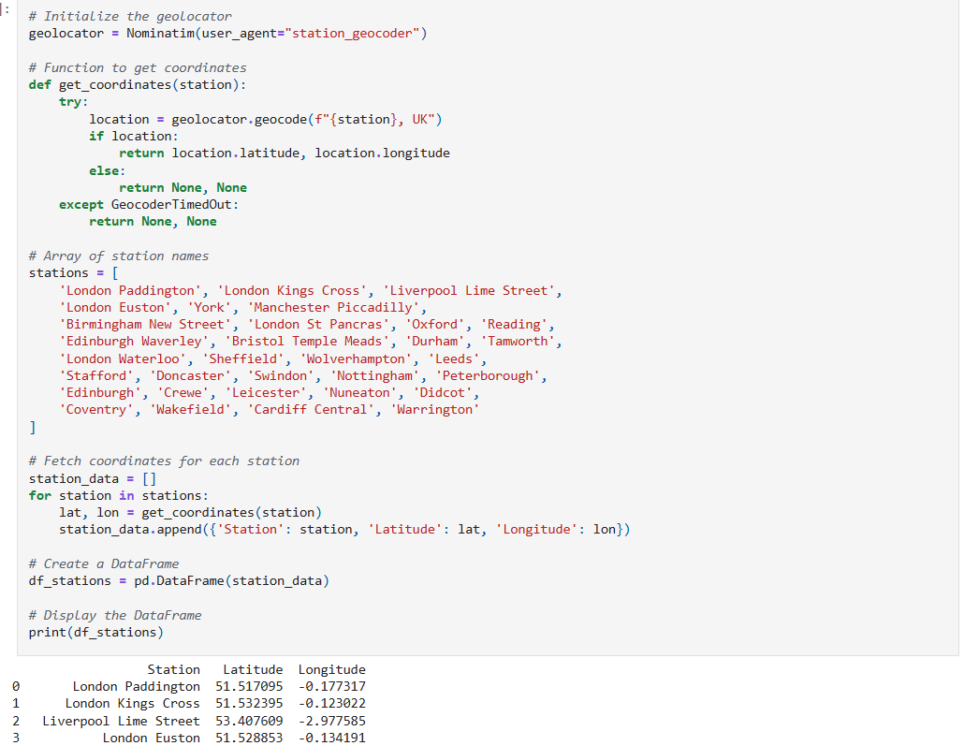
Data Cleaning, Wrangling and Normalization
🌍 Fetching Coordinates for Stations Using Geopy
2
🎯 Objective: Use Geopy to fetch the geographical coordinates (latitude and longitude) of various stations.

Slide 39
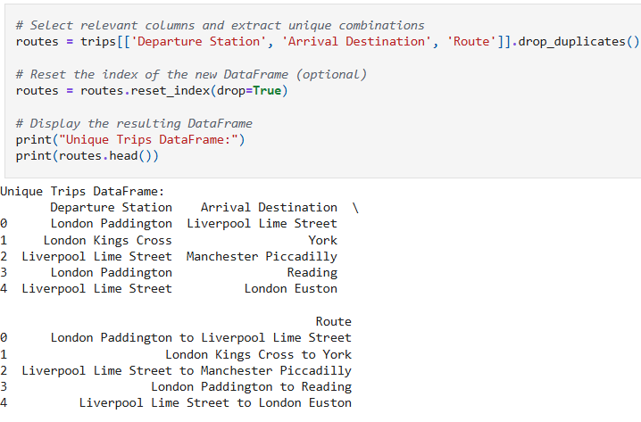
Data Cleaning, Wrangling and Normalization
Extracting Unique Trip Combinations to Create New Routes Table
2
🎯 Objective: Create a new routes DataFrame that contains only unique combinations of Departure Station, Arrival Destination, and Route.
✅ Why It Matters:
Unique Trip Routes: This step creates a clean dataset that contains only unique trip combinations, ensuring that each route appears once.
Useful for Visualizations: The unique routes dataset is helpful for creating visualizations such as route maps or charts that display trip frequencies.
Data Aggregation: This clean table of unique routes can be used for further aggregation or analysis, such as grouping trips by route or calculating metrics like average delays per route.

Slide 40

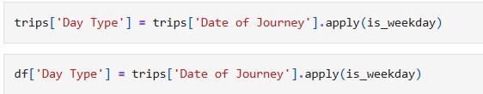
Data Cleaning, Wrangling and Normalization
🗓 Defining a Function to Classify Days as Weekday or Weekend
2
🎯 Objective: Define a function to classify a given date as either a "Weekday" or a "Weekend" based on the day of the week.
✅ Why It Matters:
Categorizing Dates: This function helps categorize dates into Weekday or Weekend, which is useful for analyzing behavior patterns.
Trend Analysis: Important for identifying trends or patterns in weekday vs. weekend behavior, such as changes in ticket sales, travel delays, or passenger volume.
Simplified Analysis: Makes it easier to perform comparative analysis between weekdays and weekends in terms of travel-related data or other metrics.
Behavioral Insights: Helps distinguish between the types of activities that happen on weekdays versus weekends, enabling more accurate insights.

Slide 41
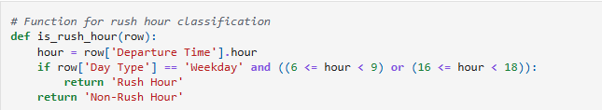
Data Cleaning, Wrangling and Normalization
Trip Time Segmentation
2
🎯 Objective: Classify departure times as either "Rush Hour" or "Non-Rush Hour" based on Day Type (Weekday/Weekend) and Time of Departure.
🧠 What We Did:
Rush Hour Classification:
Day Type (Weekday/Weekend): Rush hour typically occurs only on weekdays.
Time of Departure:
Morning Rush Hour: 6 AM – 9 AM
Evening Rush Hour: 4 PM – 6 PM
Created categories to identify when trips occur during peak travel hours.
✅ Why It Matters:
Demand Analysis: Identifying peak travel times helps optimize pricing strategies (e.g., surge pricing during rush hours).
Customer Behavior Insights: Helps understand when passengers are most likely to travel, providing actionable insights for customer-focused improvements.
Dynamic Pricing Models: Can be used to adjust fares based on demand, applying higher prices during rush hours to manage capacity.

Slide 42
Data Cleaning, Wrangling and Normalization
Reverse Engineering to Obtain Original Price of Tickets Before Discounts
2
🎯 Objective: Calculate the original ticket price before discounts were applied based on known discount structures, and add a new column for the 'Original Price' in the DataFrame.
🧠 What We Did:
Created a function to reverse engineer ticket prices based on various discount types:
Railcard Discounts: Multiplies the ticket price by 3/2 to reverse a 1/3 discount (e.g., £60 → £90).
Advance Tickets: Doubles the price to reverse a 50% discount.
Off-Peak Tickets: Multiplies by 4/3 to reverse a 25% discount.
Applied the function to each row using apply(axis=1) to calculate and add the 'Original Price' column to the DataFrame.
✅ Why It Matters:
Data Enrichment: Provides additional insight into the original prices of tickets before any discounts were applied, which is crucial for pricing analysis or revenue calculations.
Accurate Pricing Analysis: Helps in understanding the full pricing structure of tickets, even if only the discounted price is available.
Ticket Type Classification: Enables better analysis by providing clear insight into how different discount types affect ticket prices.

Slide 43
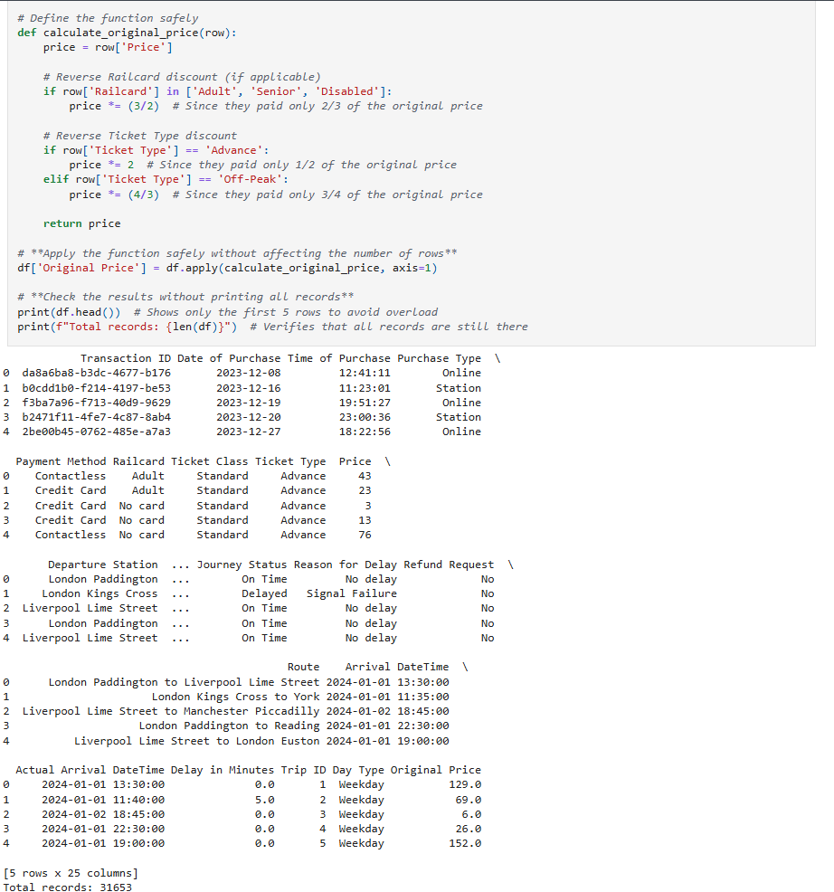
Data Cleaning, Wrangling and Normalization
Reverse Engineering to Obtain Original Price of Tickets Before Discounts
2
🎯 Objective: Calculate the original ticket price before discounts were applied based on known discount structures, and add a new column for the 'Original Price' in the DataFrame.

Slide 44
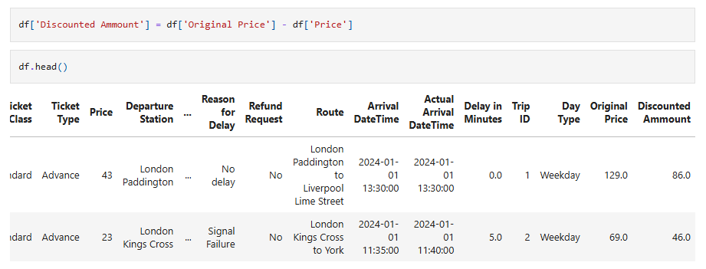
Data Cleaning, Wrangling and Normalization
Calculating the Discounted Amount (Revenue Loss)
2
🎯 Objective: Calculate the exact monetary value of discounts applied to each ticket, making the savings amount explicit, and provide a precise measure of revenue loss due to discounts.
🧠 What We Did:
Created a new column that shows the discounted amount (or revenue loss) for each ticket:
Subtracted the paid price from the reconstructed original price to calculate the discount value.
This is a simple arithmetic operation:
Notes:
✅ Why It Matters:
Quantifying Discount Impact: Allows us to see how much revenue is lost due to discounts, making the savings explicit.
Financial Analysis: Helps in measuring the financial impact of discounts across different ticket types and railcards, enabling better revenue forecasting.
Detailed Insights: Enables an in-depth understanding of how different discount types affect the overall revenue.

Slide 45
Introduction to Dataset
Data Cleaning, Wrangling and Normalization
Exploratory Data Analysis and Analysis Questions
Data Visualization Using Tableau
Predictions of Customer Retention
Recommendations and Conclusion
1
2
3
4
5
6

Slide 46

Exploratory Data Analysis and Analysis Questions
3
📊 Chapter 4:
Exploratory Data Analysis (EDA)
And Analysis Questions
Perform an in-depth exploration of the dataset to uncover patterns, relationships, and insights. EDA is an essential first step to understanding the data before moving on to further analysis or modeling.

Slide 47






Analysis Questions have been divided into six categories to enhance analysis and make documentation easier
Temporal & Delay Analysis
Customer
Segmentation
Pricing &
Revenue
Geospatial Analysis
Purchase Behavior
Performance Analysis

Slide 48
What is the overall punctuality rate of journeys?
Calculate the percentage of journeys that were "On Time" versus "Delayed."
Which routes or stations experience the most delays?
Identify patterns in delays by analyzing the Departure Station and Arrival Destination.
What are the most common reasons for delays?
Analyze the Reason for Delay column to determine recurring issues.
How does delay impact customer satisfaction?
Investigate whether delayed journeys correlate with higher refund requests (Refund Request).
Analysis Questions have been divided into six categories to enhance analysis and make documentation easier
Temporal & Delay Analysis
Customer
Segmentation
Performance Analysis
Pricing &
Revenue
Geospatial Analysis
Purchase Behavior

Slide 49
What is the most common payment method used for ticket purchases?
Compare the frequency of Contactless versus Credit Card payments.
Is there a difference in purchase behavior between online and station purchases?
Analyze the Purchase Type column to see if certain types of tickets (e.g., Advance, Standard) are more commonly bought online versus at stations.
Are there specific days or times when ticket purchases peak?
Use the Date of Purchase and Time of Purchase columns to identify trends in purchasing behavior.
Analysis Questions have been divided into six categories to enhance analysis and make documentation easier
Purchase Behavior
Temporal & Delay Analysis
Customer
Segmentation
Performance Analysis
Geospatial Analysis
Pricing &
Revenue

Slide 50
What is the average ticket price for each route?
Group by Departure Station and Arrival Destination to calculate average prices.
Do discounts (e.g., Railcard) significantly affect ticket prices?
Compare ticket prices for transactions with and without Railcard.
What is the total revenue generated for each route?
Multiply the Price by the number of tickets sold for each route.
Analysis Questions have been divided into six categories to enhance analysis and make documentation easier
Purchase Behavior
Temporal & Delay Analysis
Customer
Segmentation
Pricing &
Revenue
Performance Analysis
Geospatial Analysis

Slide 51
What is the distribution of ticket classes (Ticket Class) and types (Ticket Type)?
Analyze how customers choose between different ticket options.
Do certain customer groups (e.g., Adult, Disabled) prefer specific routes or payment methods?
Segment the data by Railcard to explore preferences.
Are there differences in purchasing behavior based on time of day?
Analyze Time of Purchase to see if certain groups (e.g., commuters) buy tickets at specific times.
Analysis Questions have been divided into six categories to enhance analysis and make documentation easier
Purchase Behavior
Temporal & Delay Analysis
Customer
Segmentation
Performance Analysis
Geospatial Analysis
Pricing &
Revenue

Slide 52
What are the busiest routes in terms of ticket sales?
Use the Departure Station and Arrival Destination columns to identify popular routes.
How does distance between stations correlate with ticket price?
Use the additional distance variable to analyze whether longer journeys are proportionally more expensive.
Can we visualize the flow of passengers between stations?
Create a geospatial map using station coordinates to show passenger movement.
Analysis Questions have been divided into six categories to enhance analysis and make documentation easier
Purchase Behavior
Temporal & Delay Analysis
Customer
Segmentation
Performance Analysis
Geospatial Analysis
Pricing &
Revenue

Slide 53
Do delays lead to an increase in refund requests?
Compare the Journey Status and Refund Request columns to identify correlations.
What is the financial impact of delays?
Estimate the cost of refunds or compensation for delayed journeys.
Are certain routes more prone to delays than others?
Analyze the Departure Station and Arrival Destination for delayed journeys.
Are there seasonal patterns in ticket purchases?
Analyze the Date of Purchase column to identify trends over time.
Do delays occur more frequently during specific times of the day or year?
Investigate whether delays are more common during peak travel hours or holidays.
Analysis Questions have been divided into six categories to enhance analysis and make documentation easier
Purchase Behavior
Temporal & Delay Analysis
Customer
Segmentation
Performance Analysis
Geospatial Analysis
Pricing &
Revenue

Slide 54
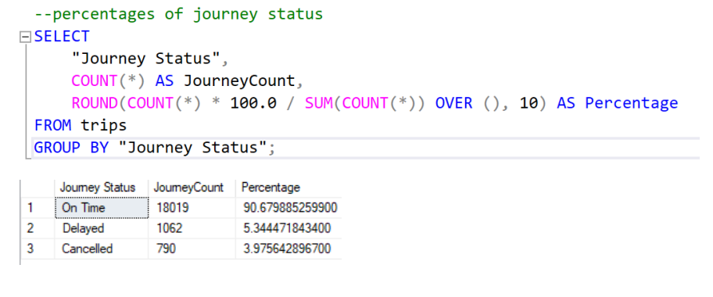
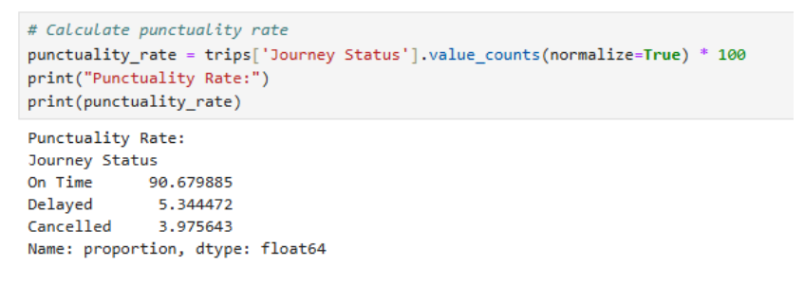
Exploratory Data Analysis and Analysis Questions
3
Samples of Business Question in Python and SQL: What is the overall punctuality performance of the train journeys (percentage of trips on time, delayed, or cancelled)?
📌 Key Findings & Implications:
Punctuality Performance:
90.7% of journeys were on time. 5.3% of journeys were delayed. 4% of journeys were cancelled.
Operational Insight:
While 90.7% on-time performance is strong, a combined 9.3% disruption (delays + cancellations) still represents a notable issue, especially in terms of passenger satisfaction.

Slide 55
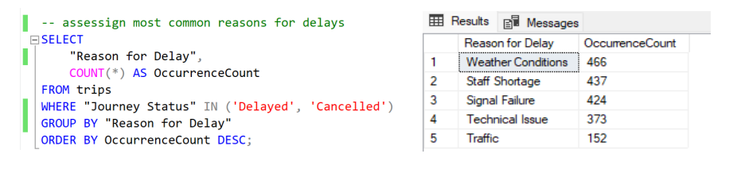
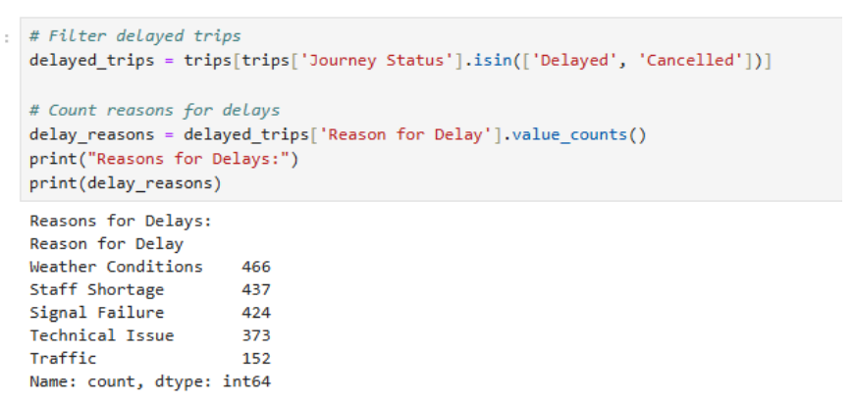
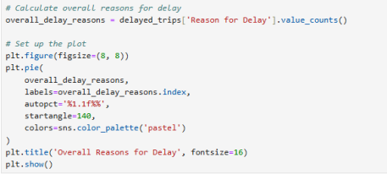
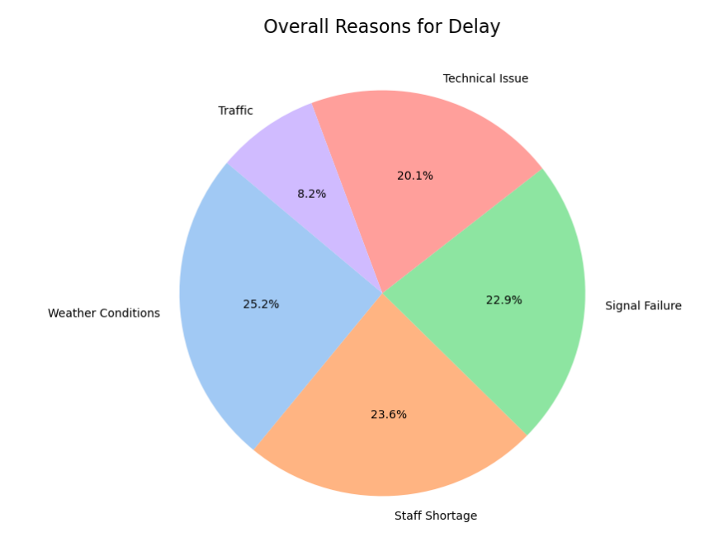
Exploratory Data Analysis and Analysis Questions
3
🎯 Business Question: What are the most common reasons for train delays and cancellations, and how can these be addressed to improve operational efficiency?

Slide 56
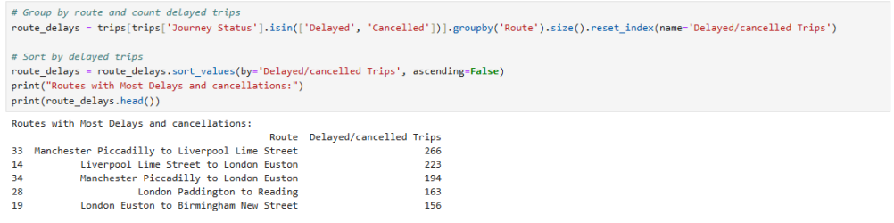
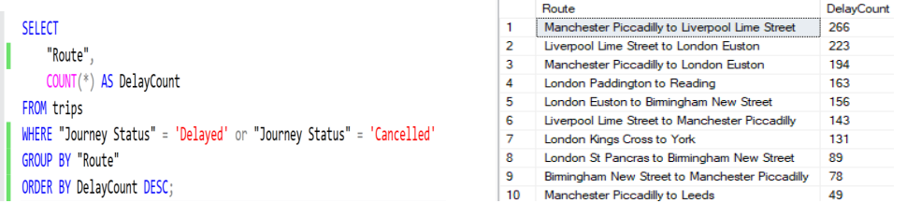
Exploratory Data Analysis and Analysis Questions
3
🎯 Business Question: Which train routes have the highest frequency of delays and cancellations, and what operational improvements can be made?
📌 Key Findings & Operational Insights:
Top 5 Disrupted Routes:
Manchester Piccadilly to Liverpool Lime Street (266 delays/cancellations)
Liverpool Lime Street to London Euston (223)
Manchester Piccadilly to London Euston (194)
London Paddington to Reading (153)
London Euston to Birmingham New Street (156)
Patterns Observed:
Major intercity routes (e.g., Manchester-London, Liverpool-London) dominate the list, suggesting there may be systemic issues that require further investigation.
London hubs (Euston, Paddington, Kings Cross) appear frequently, indicating potential congestion hotspots that may need operational improvements, such as better scheduling or infrastructure upgrades.

Slide 57
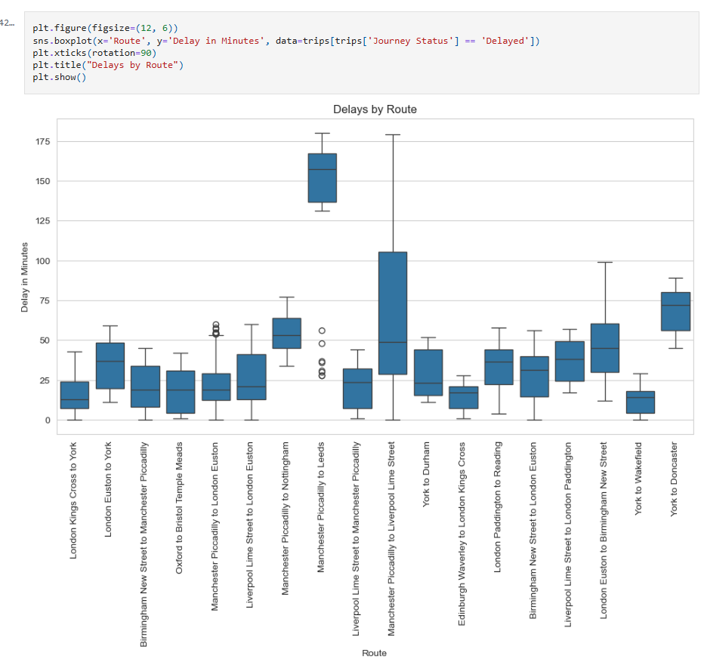
Exploratory Data Analysis and Analysis Questions
3
🎯 Business Question: What many minutes in average is noted in each departure station? Is there a specific station that exceeds other?

Slide 58
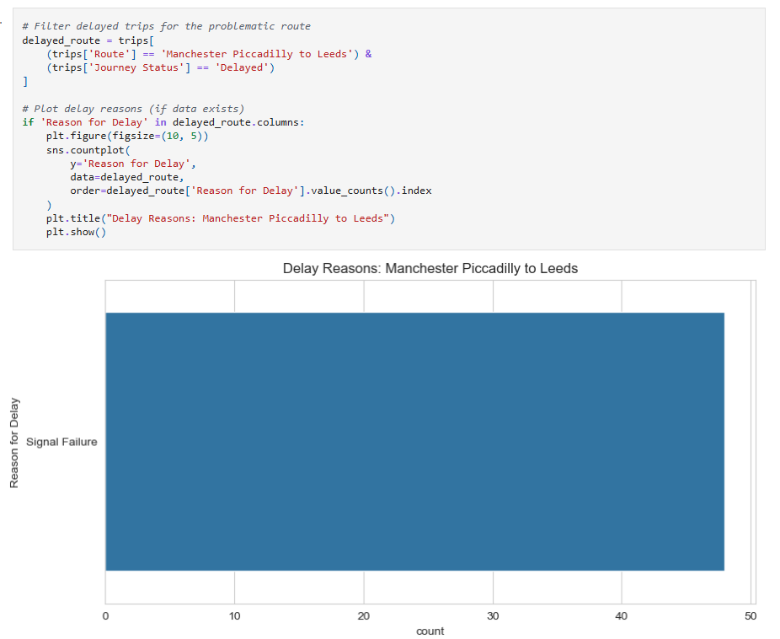
Exploratory Data Analysis and Analysis Questions
3
🛤 Further Analysis on Delays in Minutes:
Route with the Highest Delay:
The route Manchester Piccadilly to Leeds has a very high median delay as well as 1st and 3rd quartiles of delays in minutes.
Implications & Suggested Actions:
Immediate attention is required for signal failure on this route to prevent further delays.
Consider using predictive maintenance models to prevent unexpected signal failures.

Slide 59
Introduction to Dataset
Data Cleaning, Wrangling and Normalization
Exploratory Data Analysis and Analysis Questions
Data Visualization Using Tableau
Predictions of Customer Retention
Recommendations and Conclusion
1
2
3
4
5
6

Slide 60
Data Visualization Using Tableau
4
Chapter 5: Data Visualization Utilizing Tableau
To fully analyze the data and to dig as deep as possible to get the reasons behind journey disruptions, 4 different Tableau dashboards were created
Dashboard 1: Overview of Journeys and Passengers
Dashboard 2: Sales and Passengers Analysis
Dashboard 3: Latency and Cancellations Analysis (Disruptions)
Dashboard 4: Pricing and Discount Policy Analysis

Slide 61
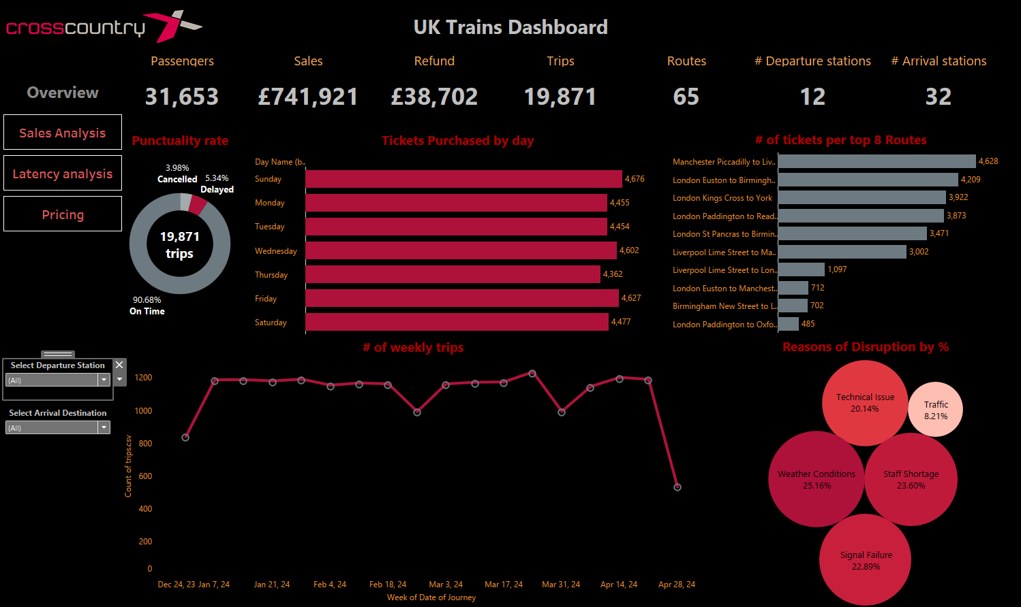
Data Visualization Using Tableau
4
Chapter 5: Data Visualization Utilizing Tableau
Dashboard 1: Overview of Journeys and Passengers
Link to Dashboard

Slide 62
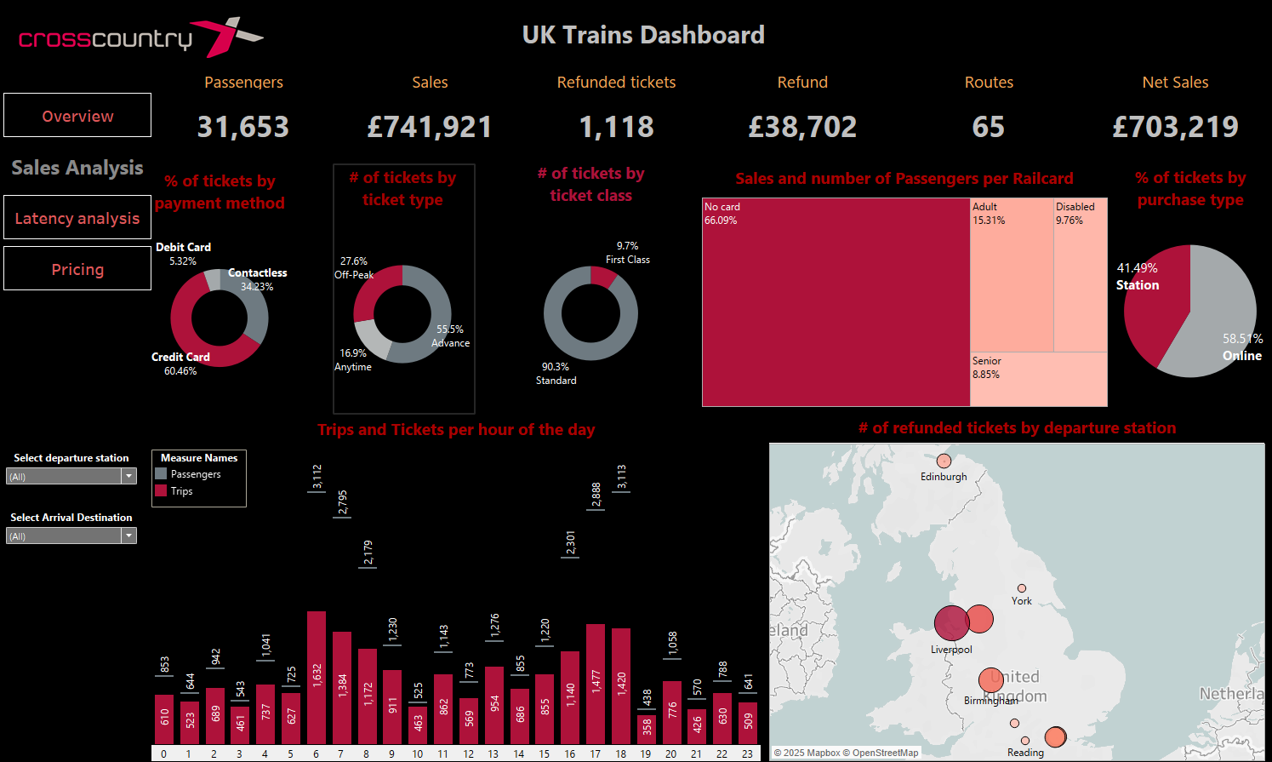
Data Visualization Using Tableau
4
Chapter 5: Data Visualization Utilizing Tableau
Dashboard 2: Sales and Passengers Analysis

Slide 63
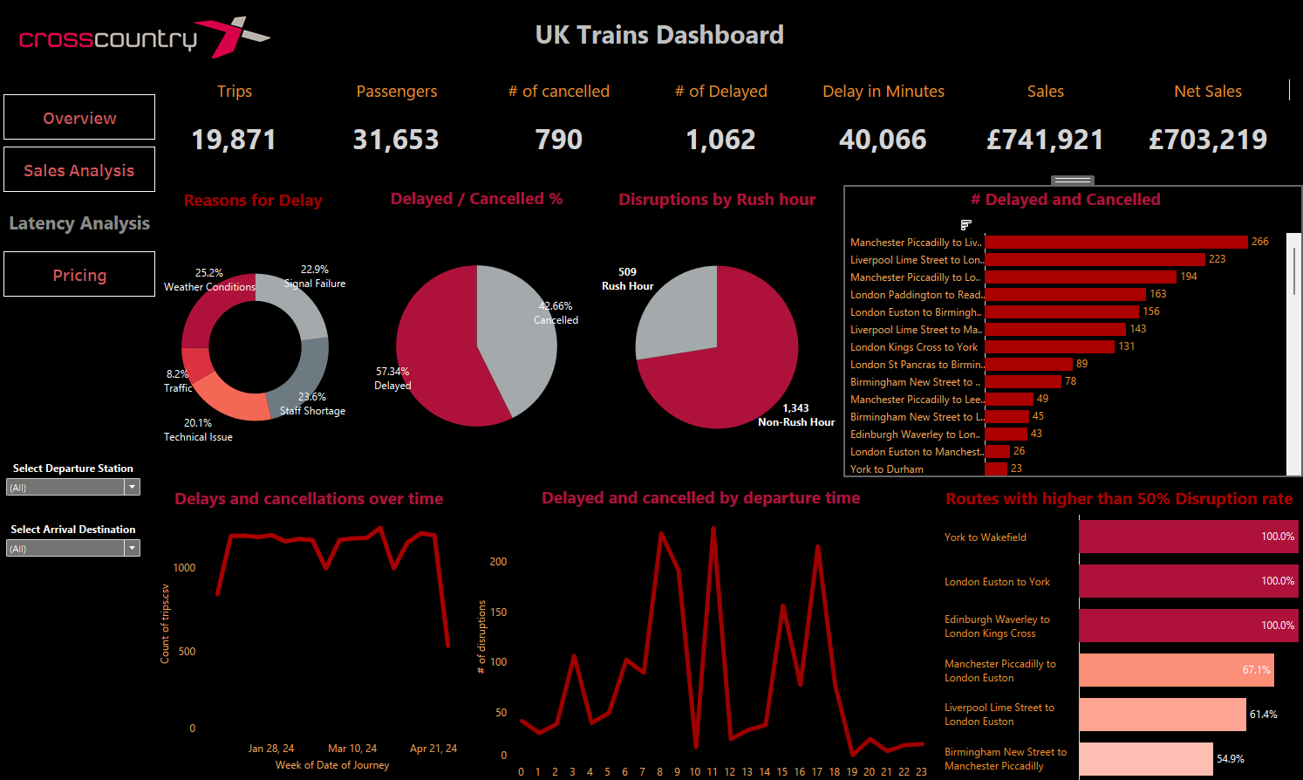
Data Visualization Using Tableau
4
Chapter 5: Data Visualization Utilizing Tableau
Dashboard 3: Latency and Cancellations Analysis (Disruptions)

Slide 64
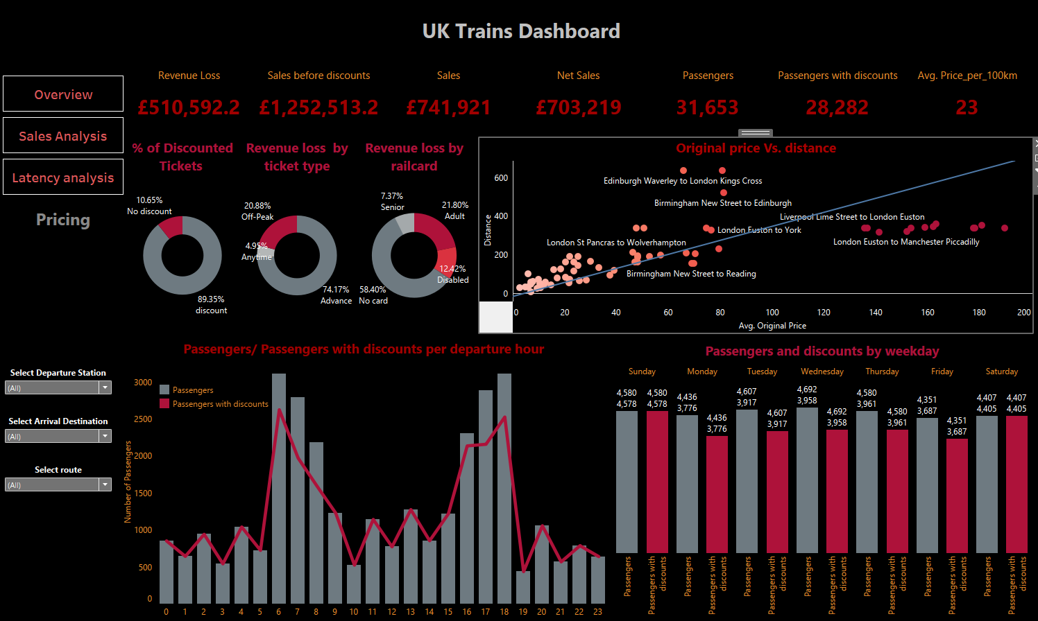
Data Visualization Using Tableau
4
Chapter 5: Data Visualization Utilizing Tableau
Dashboard 4: Pricing and Discount Policy Analysis

Slide 65
Introduction to Dataset
Data Cleaning, Wrangling and Normalization
Exploratory Data Analysis and Analysis Questions
Data Visualization Using Tableau
Predictions of Customer Retention
Recommendations and Conclusion
1
2
3
4
5
6

Slide 66
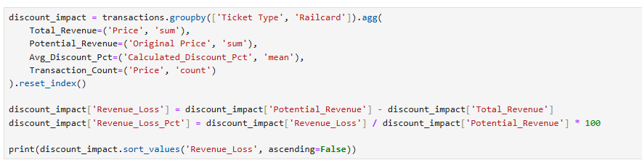
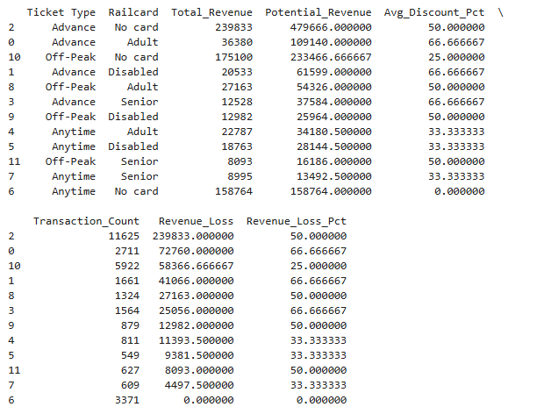
Predictions of Customer Retention
Rationale of the Prediction Analysis
5
Impact of discounts on revenue
Key Findings from Discount Impact Analysis
Maximum Revenue Loss occurs with Advance tickets:
No card holders account for £239,833 revenue loss (50% of potential)
Railcard users show 66.7% revenue loss due to combined discounts
Off-Peak Tickets show predictable losses:
Consistent 25% loss for non-railcard users
50% loss when combined with railcard discounts
Anytime Tickets demonstrate:
33.3% loss for railcard holders
No loss for non-railcard users (as expected)

Slide 67
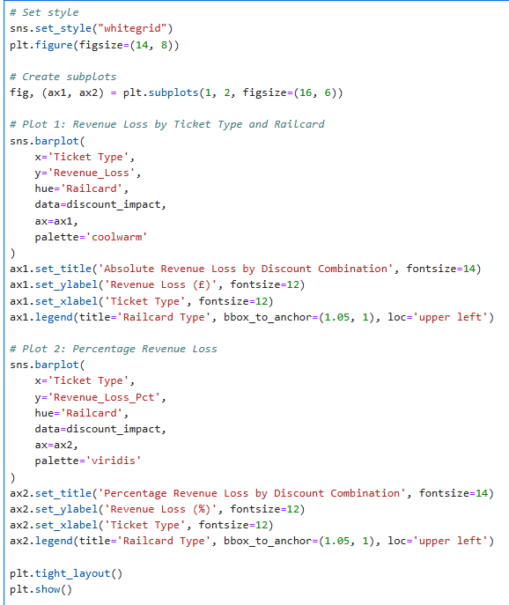
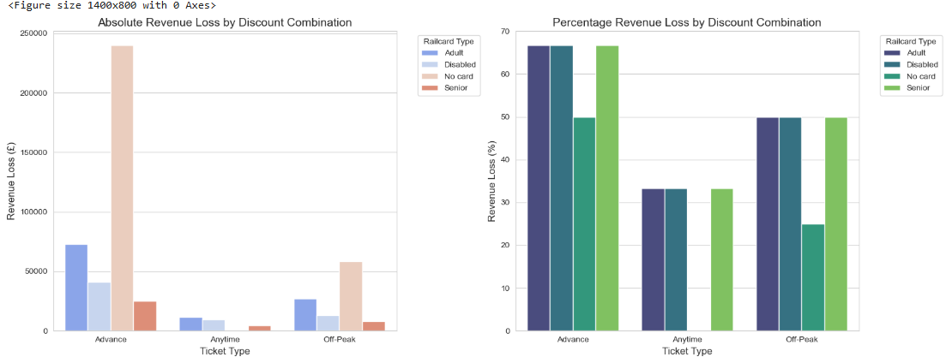
Predictions of Customer Retention
5
Rationale of the Prediction Analysis

Slide 68
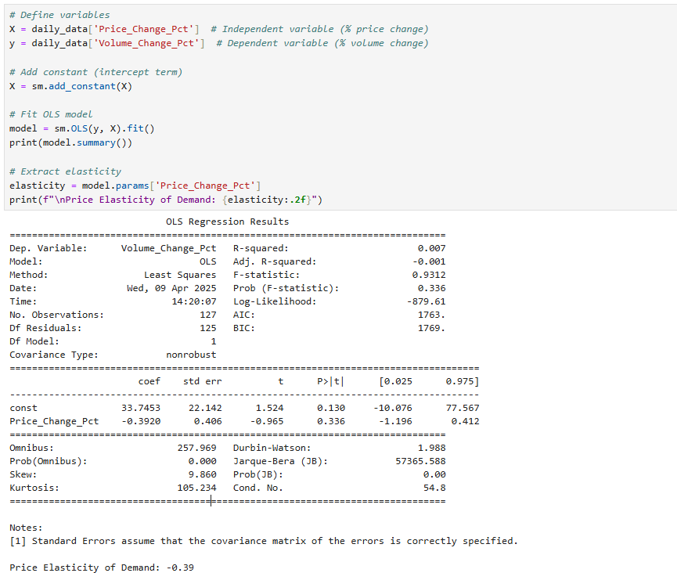
Predictions of Customer Retention
5
Price Elasticity Analysis
We tested two approaches to estimate price elasticity of demand: a simple OLS model using percentage changes, and a GLM with a Gamma distribution and log link, which is more appropriate for positive, skewed data like volume. While both models yielded non-significant results, the GLM is statistically more robust and interpretable for elasticity in this context. We estimate elasticity to be approximately -0.39 (OLS), which represents the worst-case scenario rather than GLM which gives the best estimate (-0.038).

Slide 69
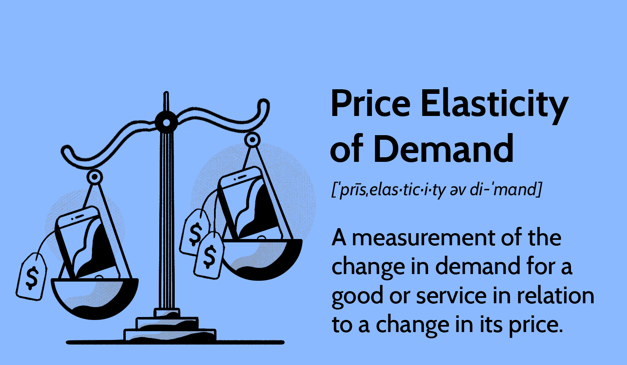
Predictions of Customer Retention
5
Price Elasticity Analysis
📘 What is Price Elasticity of Demand?
Price elasticity of demand measures how sensitive customer demand is to changes in price.
💡 How to Interpret It
Elasticity = -0.39 (as in our OLS model) means:
For every 1% increase in price, ticket sales may drop by 0.39%.
Elasticity = -0.038 (from the GLM model) suggests much weaker sensitivity.

Slide 70
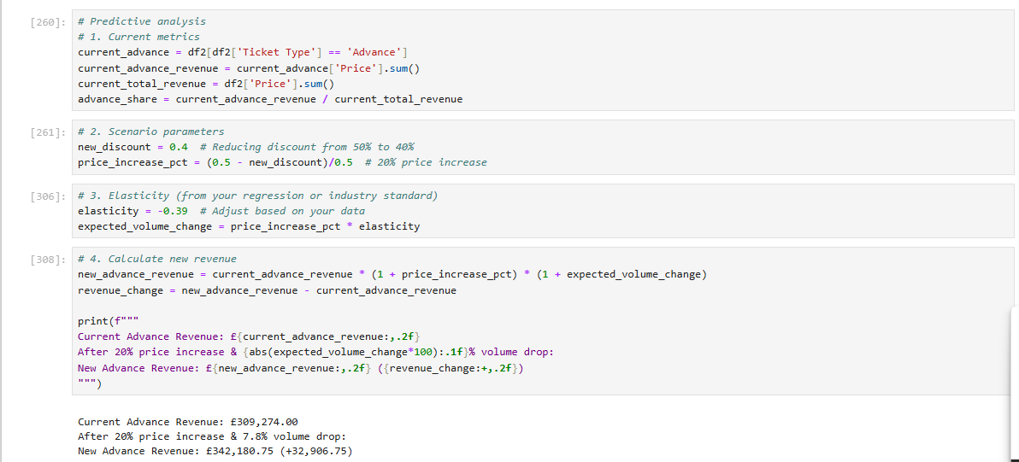
Predictions of Customer Retention
Predictions Based of Alteration of Discount Percentage of Advance tickets
5
This script forecasts the revenue impact of changing discount policies for Advance tickets using price elasticity of demand. It follows 4 key steps:
Current Baseline
Calculates existing Advance ticket revenue (£309,274)
Scenario Setup
Proposes reducing discounts from 50% → 40% (equivalent to 20% price increase)
Demand Response
Applies elasticity (-0.39) to estimate volume change: 7.8% drop = 20% price increase × -0.39 elasticity
Revenue Projection
New revenue = Price effect × Volume effect £342,181 = £309,274 × 1.20 (price) × 0.922 (volume)

Slide 71
Predictions of Customer Retention
Predictions Based of Alteration of Discount Percentage of Advance tickets
5
Key Outcomes
Revenue Increase
+£32,907 (10.6% uplift) despite lower volume
Confirms Advance tickets are price inelastic (|ε| < 1)
Tradeoffs
Gains come at the cost of 7.8% fewer customers
Potential long-term customer retention risks

Slide 72
Introduction to Dataset
Data Cleaning, Wrangling and Normalization
Exploratory Data Analysis and Analysis Questions
Data Visualization Using Tableau
Predictions of Customer Retention
Recommendations and Conclusion
1
2
3
4
5
6

Slide 73
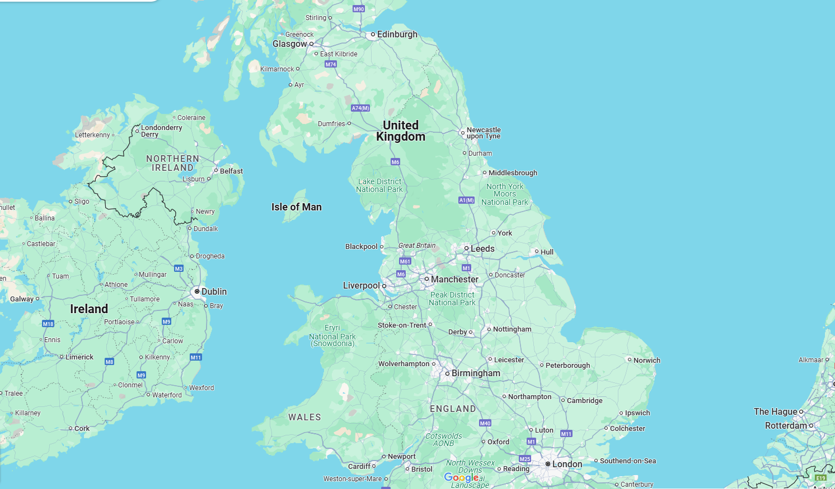
Manchester Piccadilly ↔ Liverpool Lime Street
Liverpool Lime Street ↔ London Euston
Manchester Piccadilly ↔ London Euston
London Paddington ↔ Reading
London Euston ↔ Birmingham New Street
Liverpool Lime Street ↔ Manchester Piccadilly
London Kings Cross ↔ York
London St Pancras ↔ Birmingham New Street
Birmingham New Street ↔ Manchester Piccadilly

Slide 74
Manchester Piccadilly ↔ Liverpool Lime Street
Liverpool Lime Street ↔ London Euston
Manchester Piccadilly ↔ London Euston
London Paddington ↔ Reading
Staff shortage 33% - Signal issue 27%
Install backup Signaling systems, make shifts adjustments to accommodate staff shortage
London Euston ↔ Birmingham New Street
Liverpool Lime Street ↔ Manchester Piccadilly
London Kings Cross ↔ York
London St Pancras ↔ Birmingham New Street
Birmingham New Street ↔ Manchester Piccadilly

Slide 75
Liverpool Lime Street ↔ London Euston
Manchester Piccadilly ↔ Liverpool Lime Street
Manchester Piccadilly ↔ London Euston
London Paddington ↔ Reading
London Euston ↔ Birmingham New Street
Weather problem 35% - Technical issue 35%
Pre-assess train condition before journey to avoid technical problems, prioritize weather-proofing infrastructure.
Liverpool Lime Street ↔ Manchester Piccadilly
London Kings Cross ↔ York
London St Pancras ↔ Birmingham New Street
Birmingham New Street ↔ Manchester Piccadilly

Slide 76
Manchester Piccadilly ↔ Liverpool Lime Street
Manchester Piccadilly ↔ London Euston
Liverpool Lime Street ↔ London Euston
London Paddington ↔ Reading
Weather problem 57% - Technical issue 21%
Prioritize weather-proofing infrastructure, pre-assess train condition before journey to avoid technical problems.
London Euston ↔ Birmingham New Street
Liverpool Lime Street ↔ Manchester Piccadilly
London Kings Cross ↔ York
London St Pancras ↔ Birmingham New Street
Birmingham New Street ↔ Manchester Piccadilly

Slide 77
Manchester Piccadilly ↔ Liverpool Lime Street
Liverpool Lime Street ↔ London Euston
London Paddington ↔ Reading
Manchester Piccadilly ↔ London Euston
London Euston ↔ Birmingham New Street
Liverpool Lime Street ↔ Manchester Piccadilly
London Kings Cross ↔ York
London St Pancras ↔ Birmingham New Street
Staff shortage 41% - Signal problem 20%
Install backup Signaling systems, make shifts adjustments to accommodate staff shortage
Birmingham New Street ↔ Manchester Piccadilly

Slide 78
Manchester Piccadilly ↔ Liverpool Lime Street
Liverpool Lime Street ↔ London Euston
Signal issue 37% - Weather condition 24% - Staffing problem 24%
Install backup Signaling systems, make shifts adjustments to accommodate staff shortage, prioritize weather-proofing infrastructure.
Manchester Piccadilly ↔ London Euston
London Euston ↔ Birmingham New Street
London Paddington ↔ Reading
Liverpool Lime Street ↔ Manchester Piccadilly
London Kings Cross ↔ York
London St Pancras ↔ Birmingham New Street
Birmingham New Street ↔ Manchester Piccadilly

Slide 79
Manchester Piccadilly ↔ Liverpool Lime Street
Liverpool Lime Street ↔ London Euston
Manchester Piccadilly ↔ London Euston
Technical issue 43% - Signal problem 22%
Pre-assess train condition before journey to avoid technical problems, install backup Signaling systems.
London Paddington ↔ Reading
Liverpool Lime Street ↔ Manchester Piccadilly
London Euston ↔ Birmingham New Street
London Kings Cross ↔ York
London St Pancras ↔ Birmingham New Street
Birmingham New Street ↔ Manchester Piccadilly

Slide 80
Manchester Piccadilly ↔ Liverpool Lime Street
Liverpool Lime Street ↔ London Euston
Signal issue 41%
Install backup Signaling systems
Manchester Piccadilly ↔ London Euston
London Paddington ↔ Reading
London Euston ↔ Birmingham New Street
London Kings Cross ↔ York
Liverpool Lime Street ↔ Manchester Piccadilly
London St Pancras ↔ Birmingham New Street
Birmingham New Street ↔ Manchester Piccadilly

Slide 81
Manchester Piccadilly ↔ Liverpool Lime Street
Liverpool Lime Street ↔ London Euston
Signal issue 32% - Staff shortage 24%
Install backup Signaling systems, make shifts adjustments to accommodate staff shortage
Manchester Piccadilly ↔ London Euston
London Paddington ↔ Reading
London Euston ↔ Birmingham New Street
Liverpool Lime Street ↔ Manchester Piccadilly
London St Pancras ↔ Birmingham New Street
London Kings Cross ↔ York
Birmingham New Street ↔ Manchester Piccadilly

Slide 82
Manchester Piccadilly ↔ Liverpool Lime Street
Liverpool Lime Street ↔ London Euston
Manchester Piccadilly ↔ London Euston
London Paddington ↔ Reading
London Euston ↔ Birmingham New Street
Liverpool Lime Street ↔ Manchester Piccadilly
London Kings Cross ↔ York
Birmingham New Street ↔ Manchester Piccadilly
London St Pancras ↔ Birmingham New Street
Technical issue 89%
Pre-assess train condition before journey to avoid technical problems (88.5% of disruptions).

Slide 83
Recommendations and Conclusion
6
Chapter 6: Executive Summary and Recommendations
II. Priority Actions and Strategic Recommendations
A. Immediate Operational Fixes
Staffing Shortages (especially 100% shortages):
Emergency crew scheduling (Edinburgh–London, York–Wakefield)
Competitive shift incentives and flexible scheduling
Conduct urgent audits (e.g., Edinburgh Waverley Station)
Merge under-staffed services with adjacent ones as a temporary solution
Major routes affected: Manchester Piccadilly ↔ Liverpool Lime Street, London Paddington ↔ Reading, London Euston ↔ Birmingham New Street.
Signal Failures (especially routes with 100% disruptions):
Urgent deployment of signal teams (e.g., London Euston–York)
Install temporary backup signaling systems
Initiate preemptive signal maintenance on major routes affected: Manchester Piccadilly ↔ Liverpool Lime Street, London Euston ↔ Birmingham New Street and London Kings Cross ↔ York.

Slide 84
Recommendations and Conclusion
6
Chapter 6: Executive Summary and Recommendations
B. Infrastructure & System Investments
Weather-Resilient Infrastructure:
Prioritize NW corridors (Manchester/Liverpool)
Install real-time weather monitoring
Signal System Modernization:
Upgrade for reliability, especially on Liverpool-Manchester-London Euston-Birmingham corridors.
Focus on morning rush hour performance
Proactive Maintenance:
Adopt predictive maintenance schedules across all routes
Prioritize high-failure locations like Liverpool–London Euston.

Slide 85
Recommendations and Conclusion
6
Chapter 6: Executive Summary and Recommendations
III. Revenue Optimization & Customer Experience
A. Discount and Ticketing Strategy
Advance Ticket Discounts:
Reduce blanket 50% discount to dynamic model (e.g., Early 45%, Standard 40%, Last-Minute 35%)
Restrict discount stacking (e.g., Advance + Railcard = >50% losses)
Railcards:
Re-evaluate 33% blanket discount, especially for Adult railcards
Implement tiered railcard rewards based on loyalty or volume
Peak Pricing:
Introduce dynamic pricing during high-demand windows (6–8 AM, 4–6 PM)
Upsell “Anytime/No card” segment with zero loss potential
B. Capacity and Revenue Management
Increase train capacity on high-revenue routes (e.g., London–York)
Investigate low-revenue anomalies (e.g., Birmingham–Wolverhampton)
Run promotions on moderately underperforming routes (e.g., York–Leeds, Manchester–Warrington)

Slide 86
We would like to express our sincere gratitude to the Ministry of Communications and Information Technology “MCIT” for their continuous support and efforts.
And our Deepest gratitude to the ILearn Training Company
Special Thanks to Eng. Ahmed Samir

Slide 87
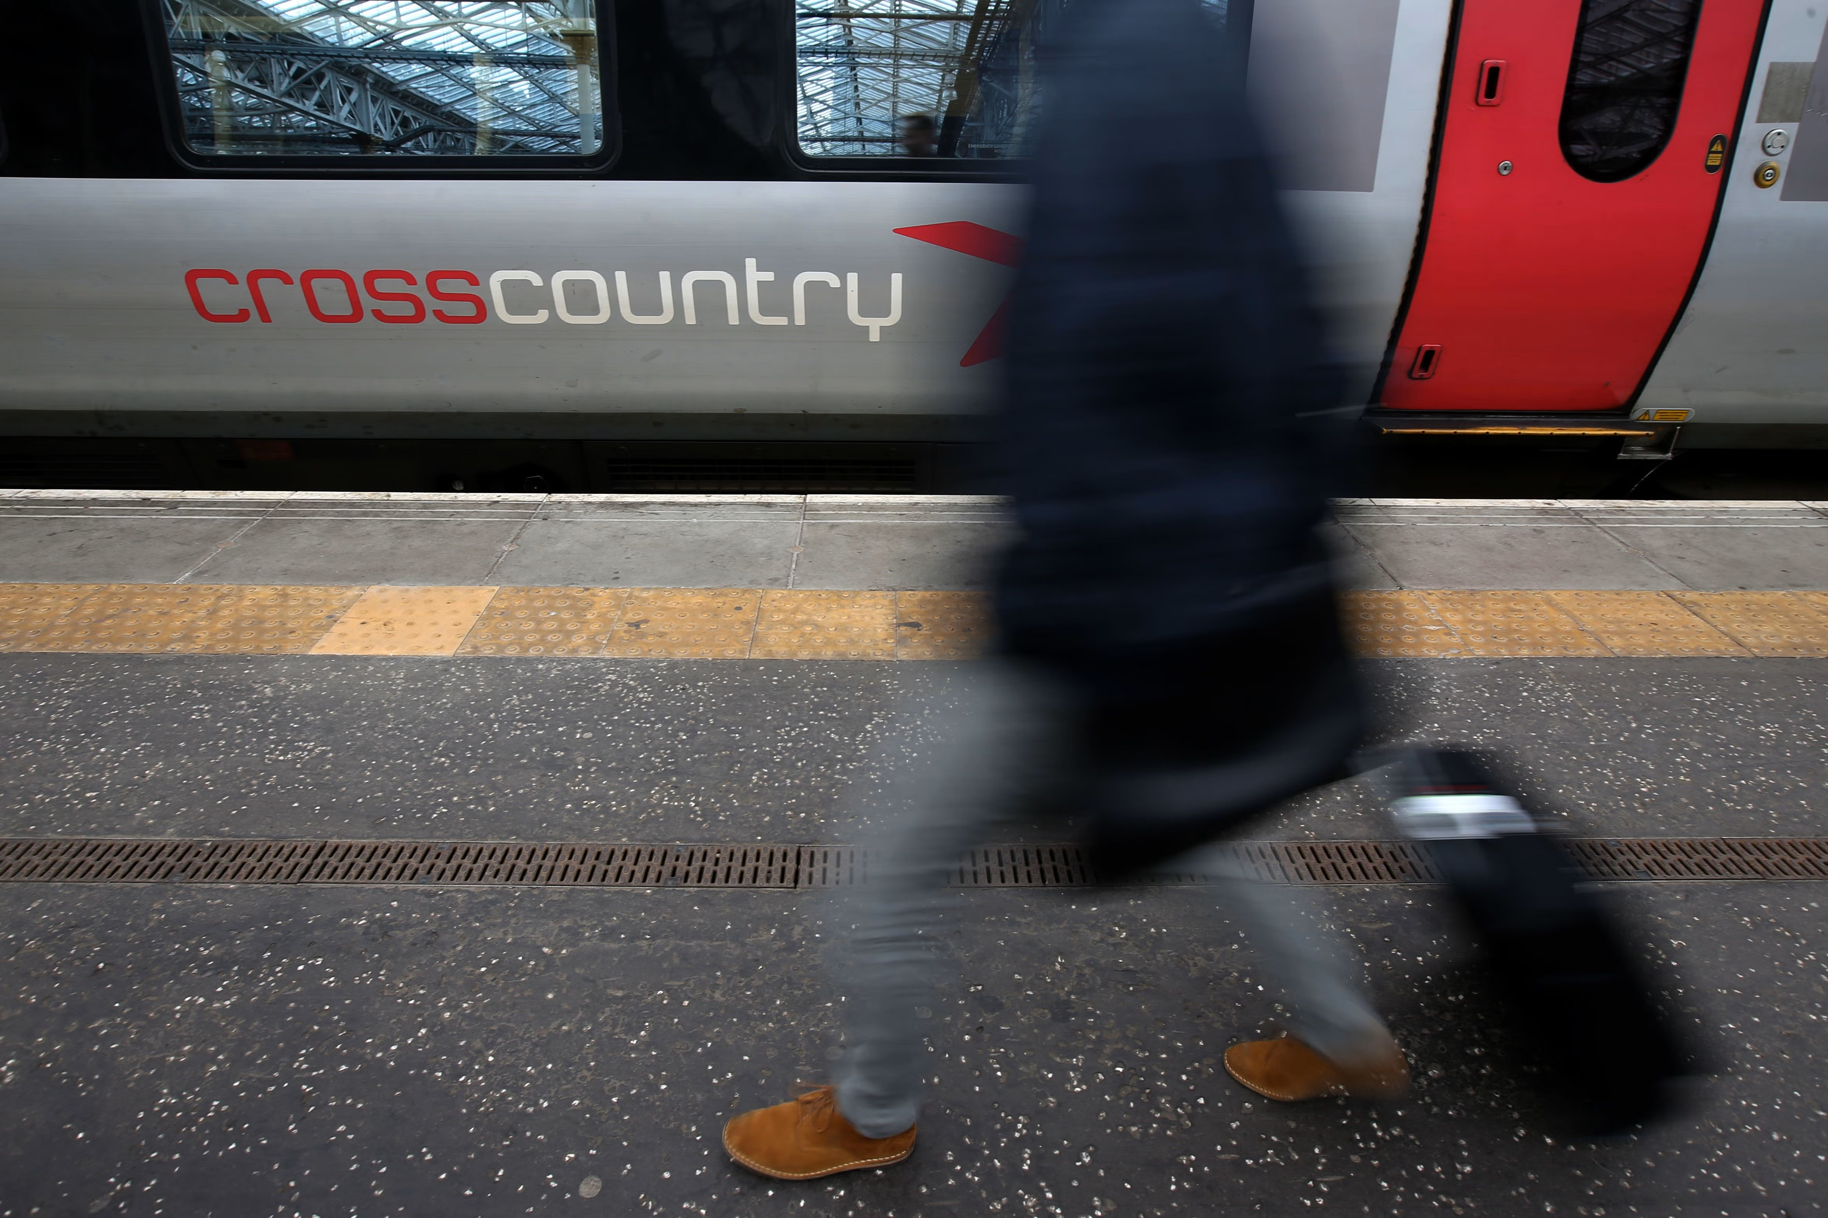
Thanks for the Attention

